Slide 1
Logic & semantics Programming Languages

Slide 2

Motivation: software correctness
Improve the quality of software, but also be more productive
Be scientific about producing correct software
Use better programming languages, e.g. type safety, compilers
Write specifications and/or use models
Understand the language (semantics)
Prove the correctness (logic, theorem provers)
Check the correctness (program analysis tools, model checkers)

Slide 3
Staff – highly motivated supervisors
Aslan Askarov (language-based security, compilation)
Compilation
Lars Birkedal (program semantics, program verification, concurrency)
Magnus Madsen (programming languages, type systems, program analysis)
Programming Café
Anders Møller (programming languages, program analysis)
Programming Languages
Andreas Pavlogiannis (software analysis, concurrency, algorithmic verification)
Jaco van de Pol (model checking, automata)
Computability & Logic
Bas Spitters (functional programming, type theory, blockchain)
Amin Timany (program verification, type theory)

Slide 4

Research questions: TYPES
Types are a great way to ensure that programs are safe and secure, but types also put some (unnecessary) limitations to the programmer
More expressive type systems: can we model … with types?
Can we check the types automatically?
Can we infer the types automatically?

Slide 5
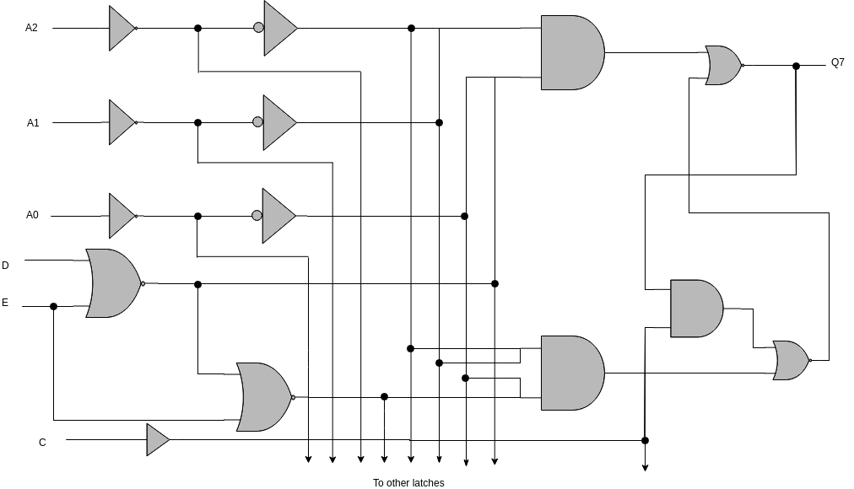
Research questions: LOGIC
Hoare Logic is a logic for simple programming languages. What about logic for object-oriented, functional, concurrent, distributed programs?
What are the rules of the logic, are they sound and complete?
Strategy to prove concrete programs, case studies
Support by interactive theorem provers

Slide 6

Research questions: Algorithms
Program verification is undecidable in general. Can we still build tools to support automatic verification for practical software?
Program analysis tools: efficient, but false alarms?
Model checking: Scalability? Parallel algorithms?
Automated test case generation
New algorithms, applications, bechmarks

